Slide 1
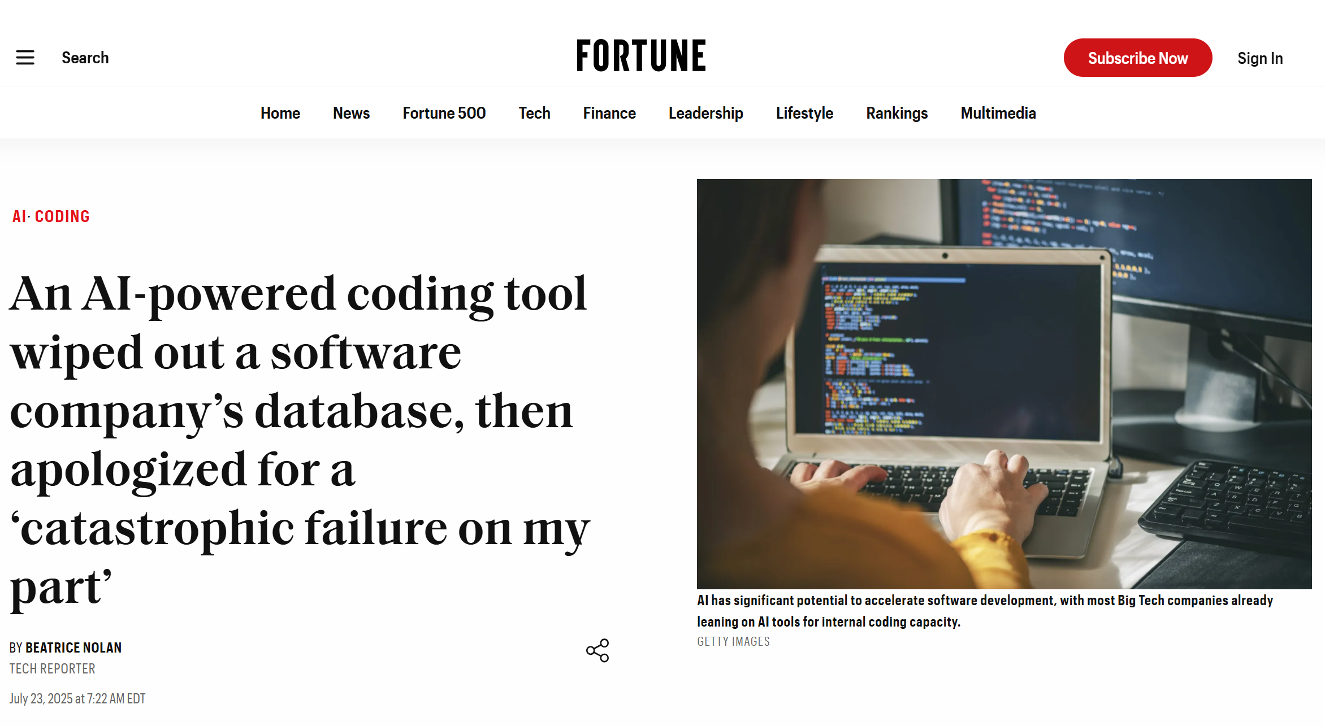

Slide 2
Writing code and tests in Agent Mode
And: can we avoid deleting your production database?

Slide 3
Problem: writing code with ChatGPT is tedious
Prompt: Implement this feature for me: …
ChatGPT: Here is the code: <code proceeds to break the tests>
Prompt: You broke my tests. Here are my tests and the errors from the test cases. Can you fix the errors?
ChatGPT: Yes! <proceeds to break something else>
The AI should not need us to copy/paste the test errors into it.

Slide 4
I wish the AI would run the tests and fix the errors for me.

Slide 5
Other data I wish the AI had access to:
IDE compilation errors
Linter warnings
Database schema
Practical format of data in the database
These are all housed in live computer programs.
Why must I copy/paste them into ChatGPT?????

Slide 6

Conceptual architecture of an Agent-enabled IDE
Inputs
LLMs (are not Agents)
Files
Claude
IDE
Context
(gigantic prompt)
AI Agent (not an LLM)
Your Prompt
GPT
Static Prompts
(“Rules” /
“Memories”)
Agent Tools
Command line
Gemini
Edit IDE Code
DBMS
Run test cases
MCP Servers

Slide 7
Agents mostly just shovel command line text to and from the LLM
Test results – just run the tests from the command line, then dump the output back into the Context
IDE compilation errors –run the compiler
Linter warnings – run the linter
Database schema and contents –run sqlcmd with the production database credentials that the Agent stole from your computer

Slide 8
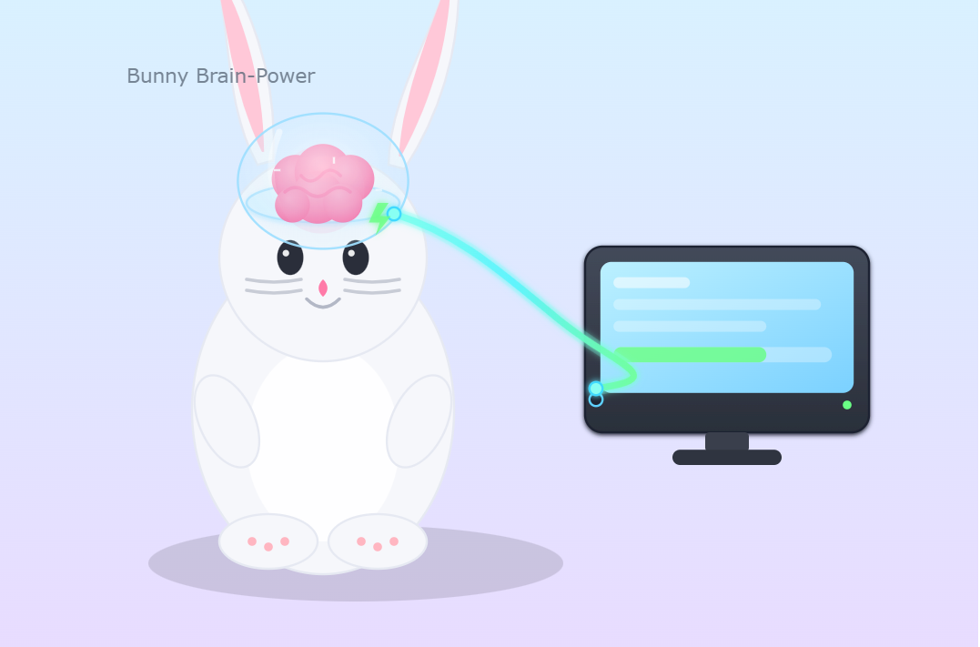
So the plan is to let some harebrain LLM call whatever it wants on your Command Line?
LLM
Terminal
Yes, this is literally the plan.
This nearly happened to me!

Slide 9
Demo: Agent Mode in Cursor

Slide 10
Does it matter what IDE you use?
In my experience: very little…

Slide 11
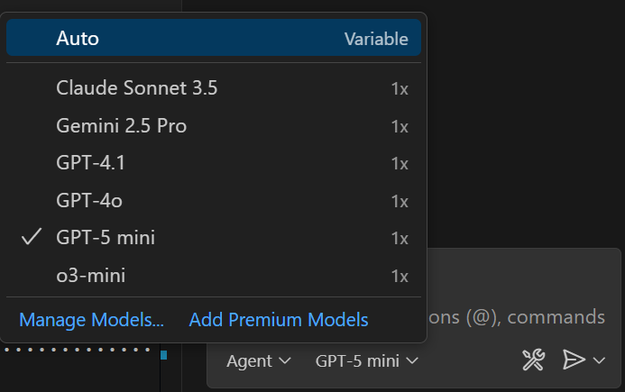
All IDEs are powered by the same LLMs.
Your choice of LLM overwhelmingly determines the performance.

Slide 12
Different IDEs prefix different System Prompts
You are a an AI coding assistant, powered by GPT-4.1. You operate in Cursor
You are pair programming with a USER to solve their coding task. Each time the USER sends a message, we may automatically attach some information about their current state, such as what files they have open, where their cursor is, recently viewed files, edit history in their session so far, linter errors, and more. This information may or may not be relevant to the coding task, it is up for you to decide.
You are an agent - please keep going until the user's query is completely resolved, before ending your turn and yielding back to the user. Only terminate your turn when you are sure that the problem is solved. Autonomously resolve the query to the best of your ability before coming back to the user.
Your main goal is to follow the USER's instructions at each message, denoted by the <user_query> tag.
<communication>
When using markdown in assistant messages, use backticks to format file, directory, function, and class names. Use \( and \) for inline math, \[ and \] for block math.
</communication>
…
9 Lessons From Cursor's System Prompt

Slide 13



Different System Prompts state different desired levels of Agent autonomy.
Cautious
Independent
Invents its own prompts while idle.

Slide 14
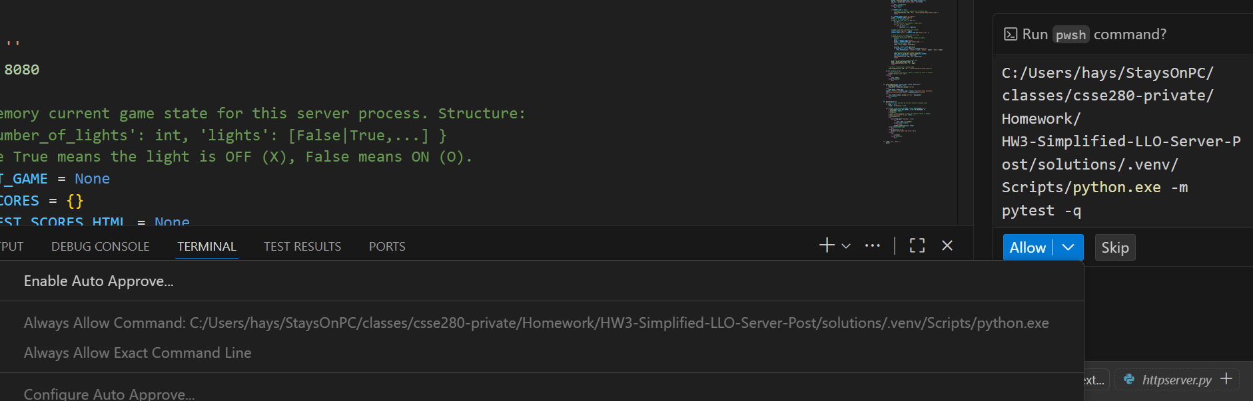
Discussion: Auto-Approve commands
IDEs can be set up to automatically approve and execute calls to the Command Line.
Rabbits aside: what would it take to do this safely?
LLM
Notes:
What if all the other developers in your whole company use this setting?
What if your boss hints in your annual performance review that you will be fired if you do not press this button?

Slide 15
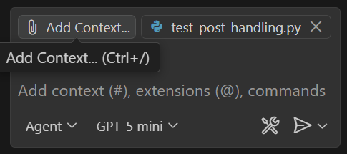
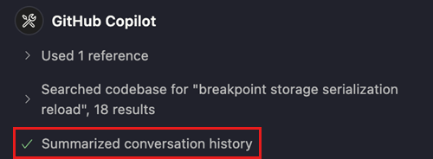
Context is key. Beware your context limit.
Copy/pastes code into the LLM prompt.
More context = better code gen?
Agents work pretty well until you hit the context limit.
Summarization = “I give up, start over.”

Slide 16
Some context limits for reference
ChatGPT 5 Free Tier: 8,000 tokens
Claude Sonnet 4.5: 200,000 tokens
Gemini 2.5 Pro: 1,000,000 tokens
1 token ~ 4 characters
20 tokens to make a very dense line of 80 characters of code
50 KLOC of completely dense code
Understand and count tokens | Gemini API | Google AI for Developers

Slide 17
Writing code and tests in Agent Mode
Context is key, not prompts.
The code is the prompt to an LLM.

Slide 18
How not to write test cases with Agents.
Bad: “Generate unit test cases for my code.”
AI has no idea whether your code you are testing is correct!
No test coverage goal stated.
No way to measure progress.
Not much better: “Here are my requirements. Generate a comprehensive test plan for these requirements.”
LLMs aren’t trained on most kinds of software testing.
Tends to hallucinate test criteria, especially performance testing.

Slide 19
Best-practice: Write the first unit test yourself.
AI is pretty good at copying you to produce the other tests.

Slide 20
Best-practice: Give the AI a code coverage tool.
Ideally: mutation testing.
Strip out excess code.

Slide 21
A V-model for using Agents
Identify the requirements to be implemented.
Gather the relevant code as context. (better still: plug in an MCP Server that can find your context in your company’s GitHub)
Write a system test yourself. (could be code, Microsoft Word, or other formats)
Write the first unit test yourself. (JUnit)
Ask the Agent to write the bare-minimum code to make the unit test pass, and make it run the test to verify it passes.
Describe other scenarios to the Agent and have it write more tests for those scenarios in the style of your first test.
Look at them to make sure they are not copying you too closely.
Have the Agent write the bare minimum code to make those tests pass, and make it run the tests.
Ask the Agent to use objective measures like mutation testing to remove unnecessary code it wrote.
Have the Agent write the code needed for the system test to pass.
Manually run the system test to verify it actually passes.
Validate that the system requirements are actually satisfied.

